Slide 2
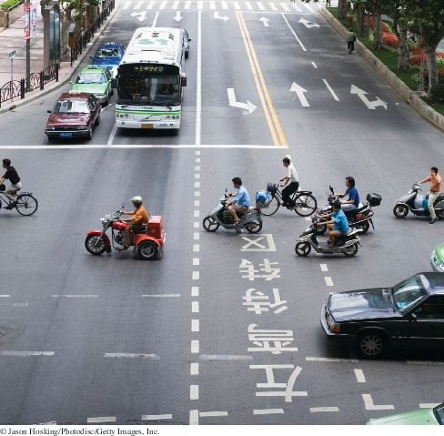
Chapter Goals
To learn about inheritance
To implement subclasses that inherit and override superclass methods

Slide 3
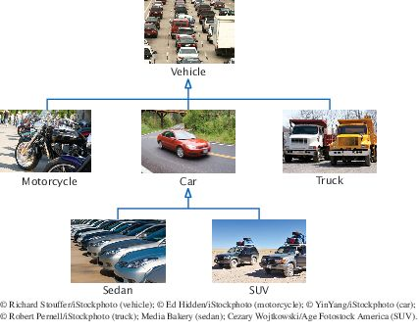
Inheritance Hierarchies
Inheritance: the relationship between a more general class (superclass) and a more specialized class (subclass).
The subclass inherits data and behavior from the superclass.
Cars share the common traits of all vehicles
Example: the ability to transport people from one place to another
Figure 1 An Inheritance Hierarchy of Vehicle Classes

Slide 4
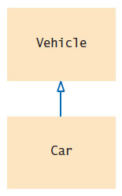
Inheritance Hierarchies
The class Car inherits from the class Vehicle
The Vehicle class is the superclass
The Car class is the subclass
Figure 2 Inheritance Diagram

Slide 5
Inheritance Hierarchies
Inheritance lets you can reuse code instead of duplicating it.
Two types of reuse
A subclass inherits the methods of the superclass
Because a car is a special kind of vehicle, we can use a Car object in algorithms that manipulate Vehicle objects
The substitution principle:
You can always use a subclass object when a superclass object is expected.
A method that processes Vehicle objects can handle any kind of vehicle

Slide 6
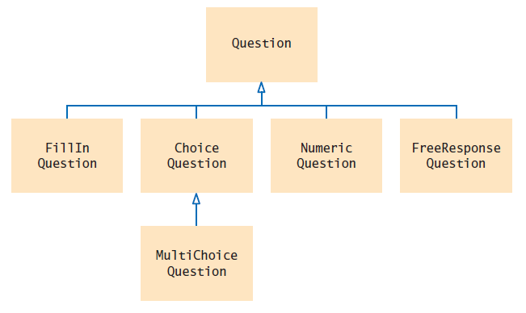
Inheritance Hierarchies
Figure 3 Inheritance Hierarchy of Question Types
Example: Computer-graded quiz
There are different kinds of questions
A question can display its text, and it can check whether a given response is a correct answer.
You can form subclasses of the Question class.

Slide 7
section_1/Question.java
1 /**
2 A question with a text and an answer.
3 */
4 public class Question
5 {
6 private String text;
7 private String answer;
8
9 /**
10 Constructs a question with empty question and answer.
11 */
12 public Question()
13 {
14 text = "";
15 answer = "";
16 }
17
18 /**
19 Sets the question text.
20 @param questionText the text of this question
21 */
22 public void setText(String questionText)
23 {
24 text = questionText;
25 }
26
Continued

Slide 8
section_1/Question.java
27 /**
28 Sets the answer for this question.
29 @param correctResponse the answer
30 */
31 public void setAnswer(String correctResponse)
32 {
33 answer = correctResponse;
34 }
35
36 /**
37 Checks a given response for correctness.
38 @param response the response to check
39 @return true if the response was correct, false otherwise
40 */
41 public boolean checkAnswer(String response)
42 {
43 return response.equals(answer);
44 }
45
46 /**
47 Displays this question.
48 */
49 public void display()
50 {
51 System.out.println(text);
52 }
53 }

Slide 9
section_1/QuestionDemo1.java
1 import java.util.Scanner;
2
3 /**
4 This program shows a simple quiz with one question.
5 */
6 public class QuestionDemo1
7 {
8 public static void main(String[] args)
9 {
10 Scanner in = new Scanner(System.in);
11
12 Question q = new Question();
13 q.setText("Who was the inventor of Java?");
14 q.setAnswer("James Gosling");
15
16 q.display();
17 System.out.print("Your answer: ");
18 String response = in.nextLine();
19 System.out.println(q.checkAnswer(response));
20 }
21 }
22
Continued

Slide 10
section_1/QuestionDemo1.java
Program Run:
Who was the inventor of Java?
Your answer: James Gosling
true

Slide 11
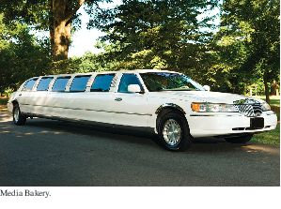
Implementing Subclasses
Like the manufacturer of a stretch limo, who starts with a regular car and modifies it, a programmer makes a subclass by modifying another class.
To get a ChoiceQuestion class, implement it as a subclass of Question
Specify what makes the subclass different from its superclass.
Subclass objects automatically have the instance variables that are declared in the superclass.
Only declare instance variables that are not part of the superclass objects.

Slide 12
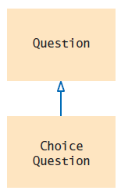
Implementing Subclasses
A subclass inherits all methods that it does not override.
Figure 4 The ChoiceQuestion Class is a Subclass of the Question Class.

Slide 13
Implementing Subclasses
The subclass inherits all public methods from the superclass.
You declare any methods that are new to the subclass.
You change the implementation of inherited methods if the inherited behavior is not appropriate.
Override a method: supply a new implementation for an inherited method

Slide 14
Implementing Subclasses
A ChoiceQuestion object differs from a Question object in three ways:
Its objects store the various choices for the answer.
There is a method for adding answer choices.
The display method of the ChoiceQuestion class shows these choices so that the respondent can choose one of them.

Slide 15
Implementing Subclasses
The ChoiceQuestion class needs to spell out the three differences:
public class ChoiceQuestion extends Question
{
// This instance variable is added to the subclass
private ArrayList<String> choices;
// This method is added to the subclass
public void addChoice(String choice, boolean correct) { . . . }
// This method overrides a method from the superclass
public void display() { . . . }
}
The extends reserved word indicates that a class inherits from a superclass.

Slide 16
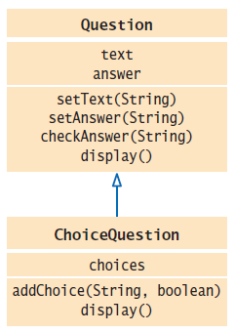
Implementing Subclasses
UML of ChoiceQuestion and Question
Figure 5 The ChoiceQuestion Class Adds an Instance Variable and a Method, and Overrides a Method

Slide 17
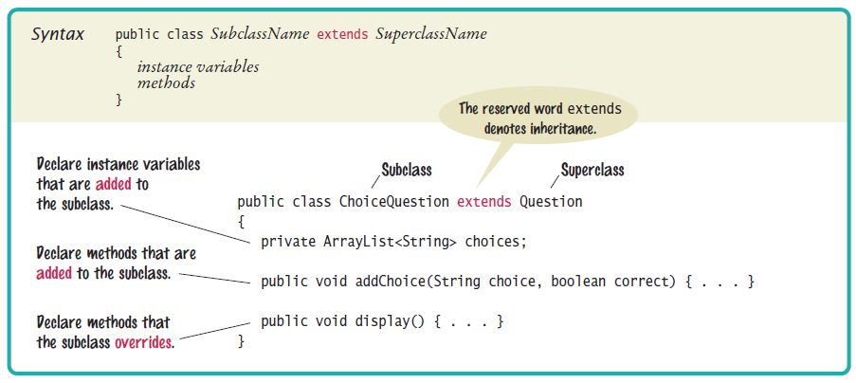
Syntax 9.1 Subclass Declaration

Slide 18
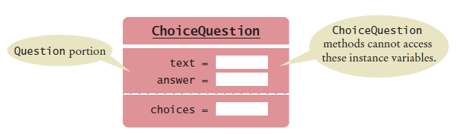
Implementing Subclasses
A ChoiceQuestion object
You can call the inherited methods on a subclass object:
choiceQuestion.setAnswer("2");
The private instance variables of the superclass are inaccessible.
The ChoiceQuestion methods cannot directly access the instance variable answer.
ChoiceQuestion methods must use the public interface of the Question class to access its private data.

Slide 19
Implementing Subclasses
Adding a new method: addChoice
public void addChoice(String choice, boolean correct)
{
choices.add(choice);
if (correct)
{
// Convert choices.size() to string
String choiceString = "" + choices.size();
setAnswer(choiceString);
}
}

Slide 20
Implementing Subclasses
addChoice method can not just access the answer variable in the superclass:
It must use the setAnswer method
Invoke setAnswer on the implicit parameter:
setAnswer(choiceString);
OR
this.setAnswer(choiceString);

Slide 21
Common Error: Replicating Instance Variables from the Superclass
A subclass has no access to the private instance variables of the superclass:
public ChoiceQuestion(String questionText)
{
text = questionText; // Error—tries to access
// private superclass variable
}
Beginner's error: “solve” this problem by adding another instance variable with same name
Error!
public class ChoiceQuestion extends Question
{
private ArrayList<String> choices;
private String text; // Don’t!
. . .
}

Slide 22
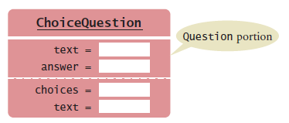
Common Error: Replicating Instance Variables from the Superclass
The constructor compiles, but it doesn’t set the correct text!
The ChoiceQuestion constructor should call the setText method of the Question class.

Slide 23
Overriding Methods
If you are not satisfied with the behavior of an inherited method,
you override it by specifying a new implementation in the subclass.
An overriding method can extend or replace the functionality of the superclass method.
The display method of the ChoiceQuestion class needs to:
Display the question text.
Display the answer choices.

Slide 24
Overriding Methods
Problem: ChoiceQuestion's display method can’t access the text variable of the superclass directly because it is private.
Solution: It can call the display method of the superclass, by using the reserved word super
public void display()
{
// Display the question text
super.display(); // OK
// Display the answer choices
. . .
}
super is a reserved word that forces execution of the superclass method.

